Slide 1
FPGA-Based Radar Signal Processing
Saket Shanbhag
Mentor: Tracee Jamison-Hooks
Arizona State University

Slide 2
Project Overview
- Millimeter wave radar can measure the 3D Mass distribution of volcanic ash inside eruption plumes and their nearby drifting ash clouds.
Millimeter wave are better matched to ash particles allowing for better sensitivity.
Useful for on-site testing of ash particle to analyze volcanic activity affects rapidly.
Primarily helpful for preventing flights from being grounded for a significant amount of time.
- Field Programmable Gate Array (FPGA) used for digital back-end.
FPGA allows for high data rate as they are massively parallel.
Allows for rapid testing and implementation due to reprogrammability.

Slide 3
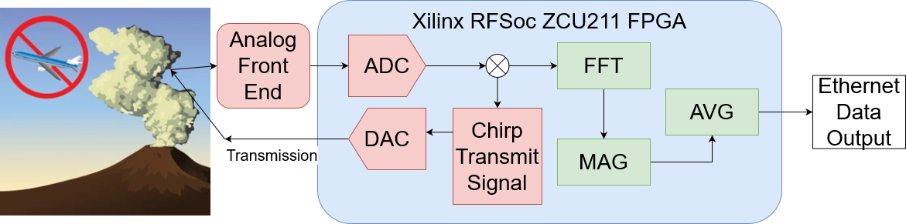
Project Overview

Slide 4
Concept Of Operations
The Chirp Signal stored in DDR Memory is transmitted via the DAC from Xilinx RFSoC FPGA.
The return signal is mixed with transmitted signal which results in high and low frequency components.
This time domain signal is transformed into its frequency components using a critically sampled polyphase filter bank which provides relative frequencies from the ash clouds
Averaging is done via the magnitude and summation blocks to increase the signal-to-noise ratio.
Data is transmitted through ethernet to a base station.

Slide 5
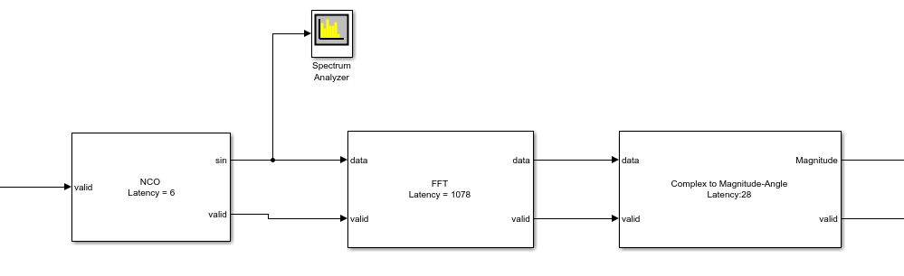
Simulation
Utilized MATLAB Simulink to create a simulation of the ‘FFT-MAG’ Section of the digital backend and ensure that the output is as expected
Numerically Controlled Oscillator used to simulate input and input frequency

Slide 6
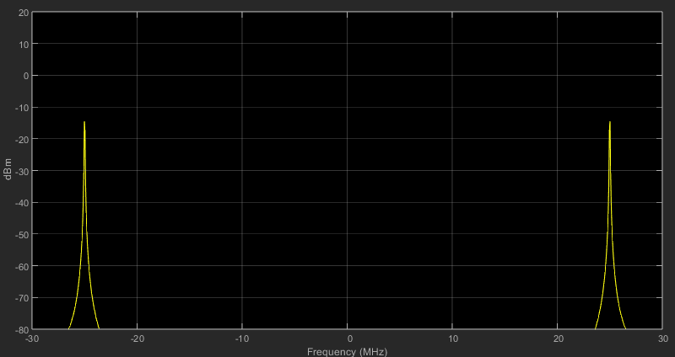
Simulation: Expected Output
Simulink output shows that the algorithm works as anticipated.
Demonstrates that the 25 MHz signal is extrapolated from the algorithm along with its mirrored signal

Slide 7
Hardware Testing
-Simulink design is coded in Hardware Description Language (HDL) in Xilinx Vivado to program the FPGA to run the necessary algorithm.
-Utilizing the Internal logic Analyzer (ILA) in Vivado, functional verification of the HDL Code is performed.
Verifies that the design behaves as expected under various input conditions.
-Signals analyzed in the ILA should demonstrate that the frequency content of the signal is detected.

Slide 8
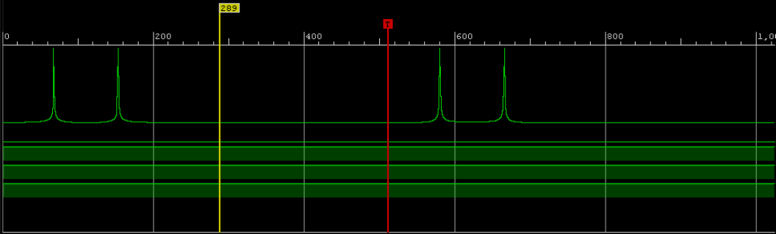
Hardware Results
ILA output on RFSoC FPGA showing successful hardware implementation of design

Slide 9
Next Steps
- The rest of the algorithm needs to designed and implemented based on the output of the RF Analog Front end once it is designed.
-Chirp Signal and frequency mixing needs to be designed, implemented and tested
- Ethernet Data output needs to be configured to allow for low-loss, high data-rate transmission.

Slide 10
Acknowledgements
I would like to thank:
Dr Tracee Jamison-Hooks and the rest of the RADAR research team
Arizona State University
NASA Arizona Space Grant

Slide 11
Thank You!
Saket Shanbhag
Arizona State University
ssshanb1@asu.edu

